Slide 1
Abstract & Concrete Classes

Slide 2
Abstract Class
An abstract class can be considered a blueprint for other classes.
A class is called an Abstract class if it contains one or more abstract methods.
An abstract method is a method that is declared, but contains no implementation.
It allows you to create a set of methods that must be created within any child classes built from the abstract class.
Abstract classes may not be instantiated, and its abstract methods must be implemented by its subclasses.

Slide 3
Use of Abstract Classes
We use an abstract class while we are designing large functional units or when we want to provide a common interface for different implementations of a component.
Useful for common Application Program Interface(API) for a set of subclasses. This capability is especially useful in situations where a third party is going to provide implementations, such as with plugins, but can also help you when working in a large team or with a large code base where keeping all classes in your mind is difficult or not possible.

Slide 4
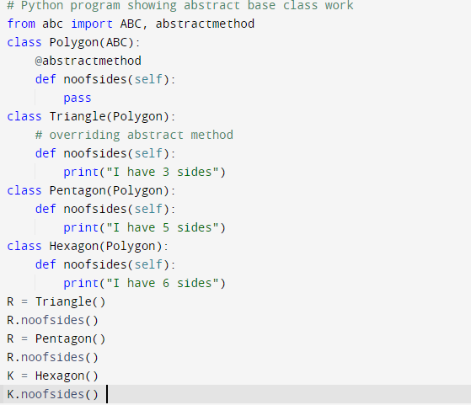
Abstract Class

Slide 5

Output

Slide 6
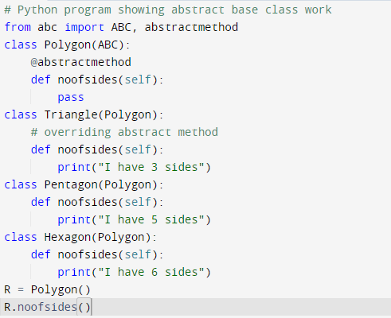
Abstract Class

Slide 7
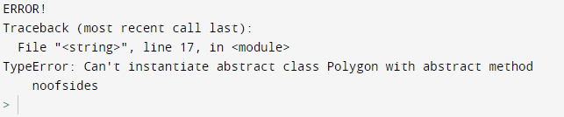
Output

Slide 8
Concrete Classes
Concrete classes contain only concrete (normal) methods whereas abstract classes may contain both concrete methods and abstract methods.

